Slide 1
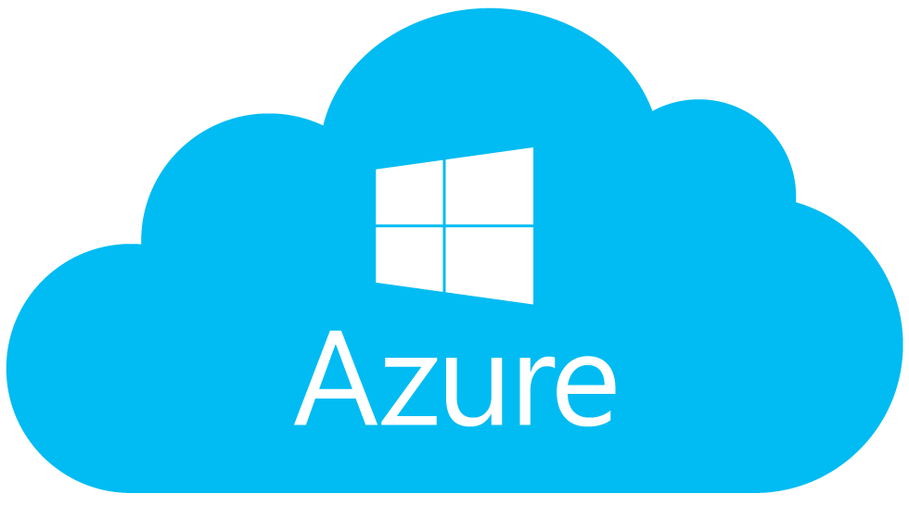
Cloud Deployment
LSI WEB PORTAL

Slide 2
Local Hosting :
Local IIS Server
Node Server
Browser

Slide 3



Source Code Migration:
Visual Studio
(Source Code)
Source Control
App Service

Slide 4
Flow Chart:
Azure Cloud
App Service
Database
Source Code
Database Script
Source Control(GIT)
SQL Server 2017

Slide 5
Resource Creation:
Create a Resource Group.
Create Web App with existing Empty Node JS Template.
Create SQL Server.
Create SQL Database.

Slide 6
Code Migration:
Open GIT and route to your project folder and initialize GIT Repository in that folder.
Follow GIT commands for basic CRUD operations and save the project in particular GIT repository.
Make the App Service to be binded to your local GIT repository just like
App Service → Deployment Options → Data Source → Local GIT Repository → OK
then add remote through GIT using GIT remote command.
Finally push data to Azure by GIT push command.
Hence, after multiple checks and tests data from inbound premises to cloud deployed.
If everything went fine then, GIT displays a confirmation message with a log file stating that
“Deployment Completed Successfully”

Slide 7
Summary:
At the completion of deployment process successfully to cloud,
Azure provides a URL for your web application with a name
added with the extension “.azurewebsites.net”.
Hence, it will be a global path for your application and can be accessed from anywhere.

Slide 8

Thank You !

